Slide 1
DATA 602
convolutional neural networks

Slide 2
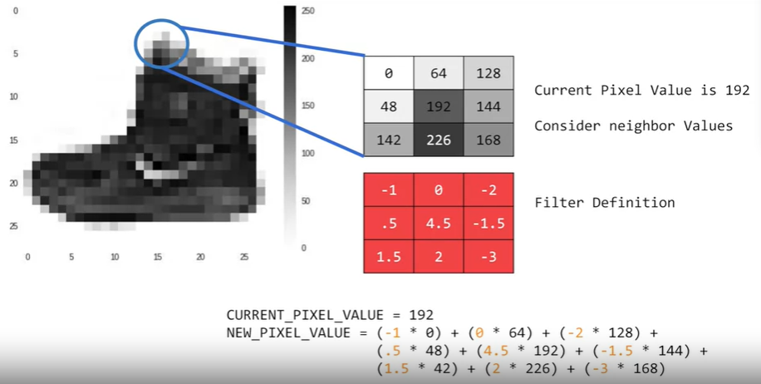
CNN – Convolution

Slide 3
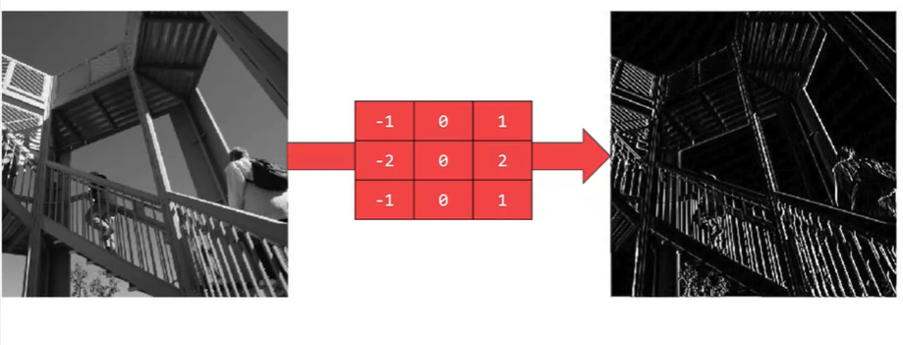
CNN – Convolution – Why do we need them?

Slide 4
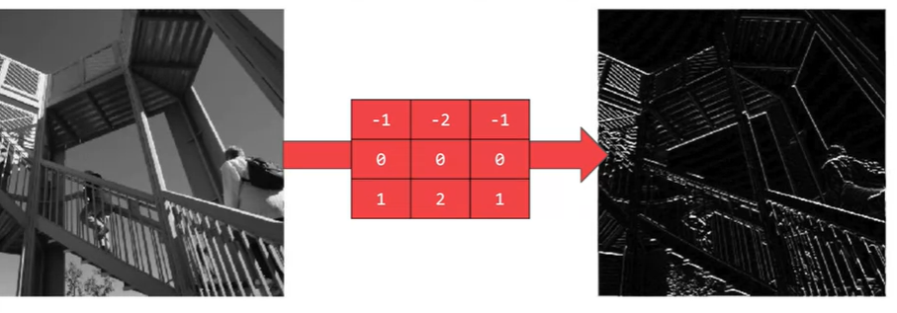
CNN – Convolution – Why do we need them?

Slide 5
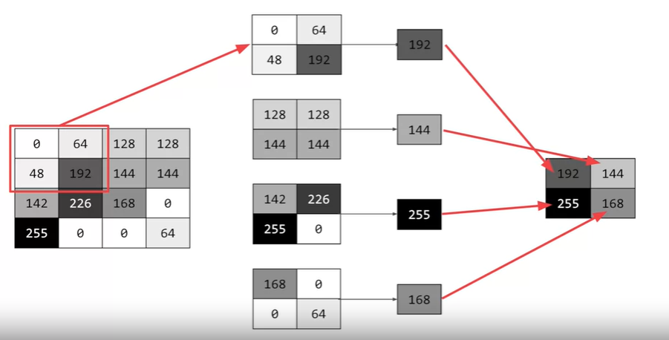
CNN – Pooling?

Slide 6
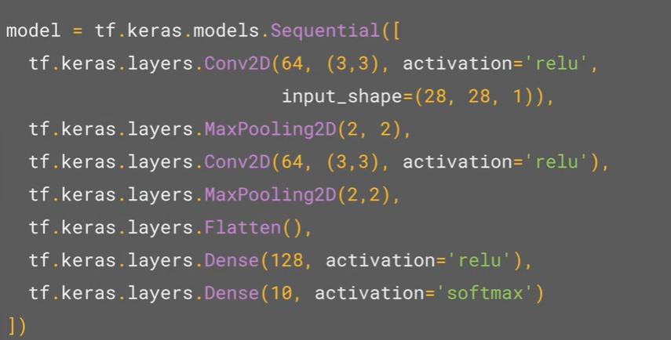
CNN – Code

Slide 7
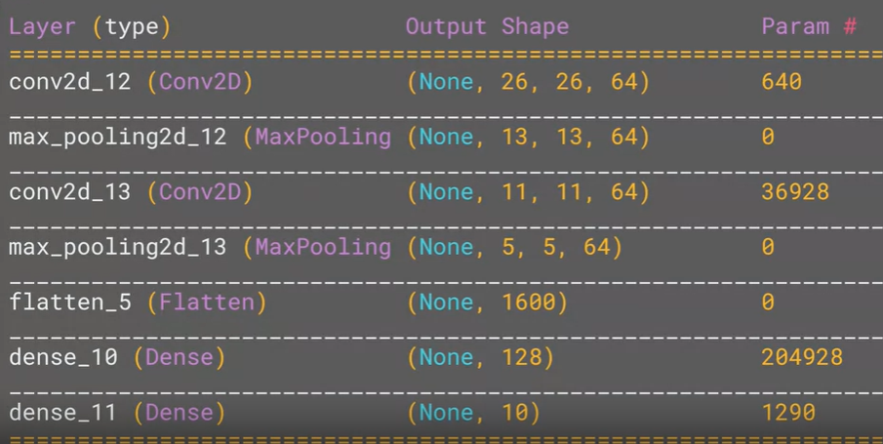
CNN – Code

